Slide 1
Public safety department
DEPARTMENT OVERVIEW
2021

Slide 2
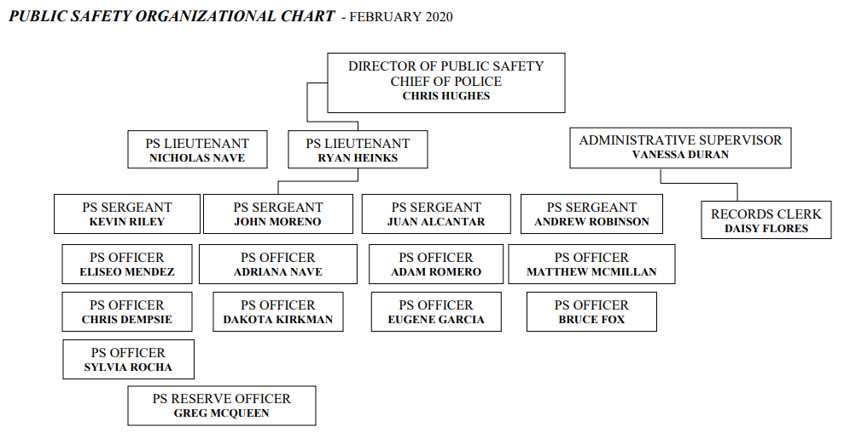
DEPARTMENT ORGANIZATIONAL CHART

Slide 3
PUBLIC SAFETY DEPARTMENT
Currently: Director and 2 Public Safety Lieutenants
13 PUBLIC SAFETY OFFICERS
4 Sergeants and 8 Patrol Officers
4 shifts on a rotational 12 hour schedule
1 School Resource Officer (LUSD Funded)
2 Administrative Staffing
1 Open Detective Position
3 Open Fire Lieutenant Positions
13,463 as of 2019
Source census.gov

Slide 4
overview

Slide 5
Public safety department
2012 Comparison:
3 Administrative Officers
14 Patrol Officers
4 Sergeants 10 Patrol Officers
1 Detective
1 School Resource Officer
4 Part-Time Officers
3 Fire Engineers
2 Animal Control Officers

Slide 6
Public Safety department
Quantity | Year | Make | Model | Source | Avg. Mileage
1 | 2020 | Toyota | Highlander | Purchased New- Insurance | 6,500
2 | 2011 | Chevy | Silverado | Purchased New | 125,500
5 | 2011 | Ford | Fusion | Purchased New | 120,000
3 | 2011 | Ford | Crown Vic. | Purchased Used | 114,000
1 | 2011 | Toyota | Highlander | Purchased New | 111,000
1 | 2007 | Ford | Crown Vic. | Purchased Used | 106,000
1 | 2006 | Ford | Crown Vic. | Purchased Used | 142,000
3 | 2006 | Toyota | Highlander | Purchased New | 125,000
1 | 2005 | Ford | Crown Vic. | Purchased Used | 148,000

Slide 7
Public Safety Department
Current Challenges:
Public Safety Model needs to change
Police and Fire Services supporting each other
Fill Fire Lieutenant Positions with Fire Professionals
Current Model cannot be sustained
Equipment upgrades and keeping up with technology
Police and Fire training in the new climate and varying techniques to adapt to the future model of policing and social justice

Slide 8
Public safety department
Criminal Cases sent to the District Attorney’s Office:
2019 Cases:
Filed: 69.21 %
Rejected for Lack of Evidence 24.01%
Rejected for further information: 3.1%

