Slide 1
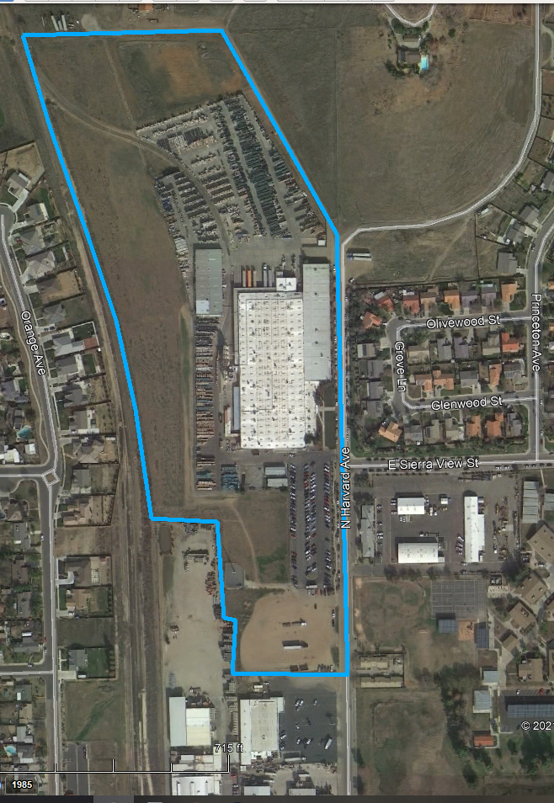
LOCATION MAP
EXHIBIT “A”
NDS, INC
Sierra View Estates
R~n Market

Slide 2
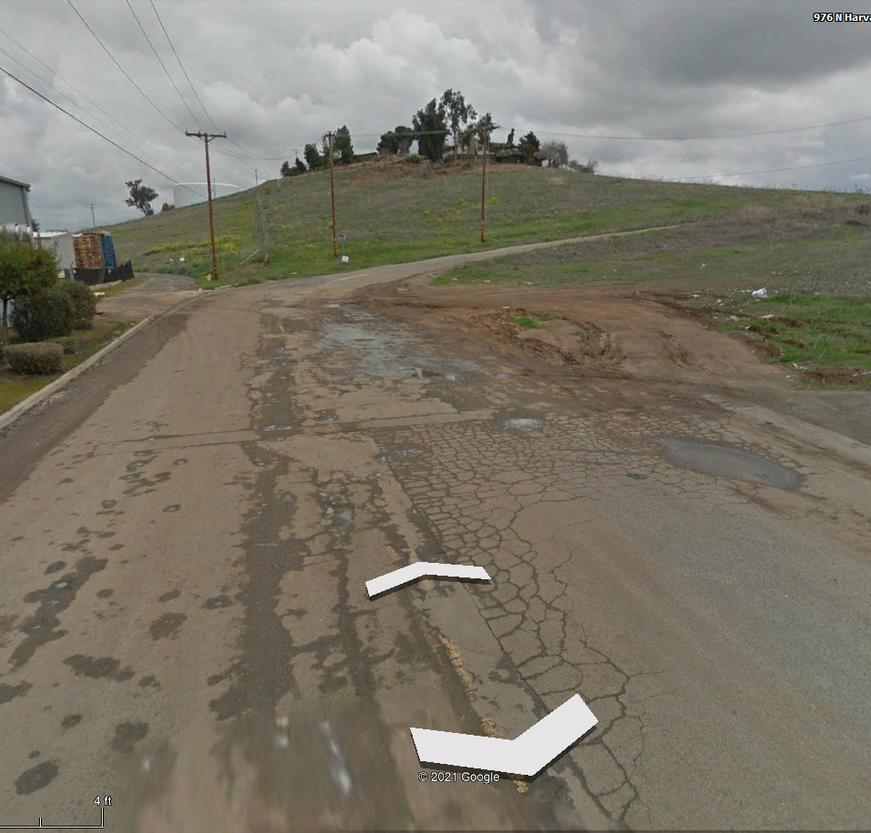
Todd’s Hill
Undeveloped Private Property
Hill’s runoff

Slide 3
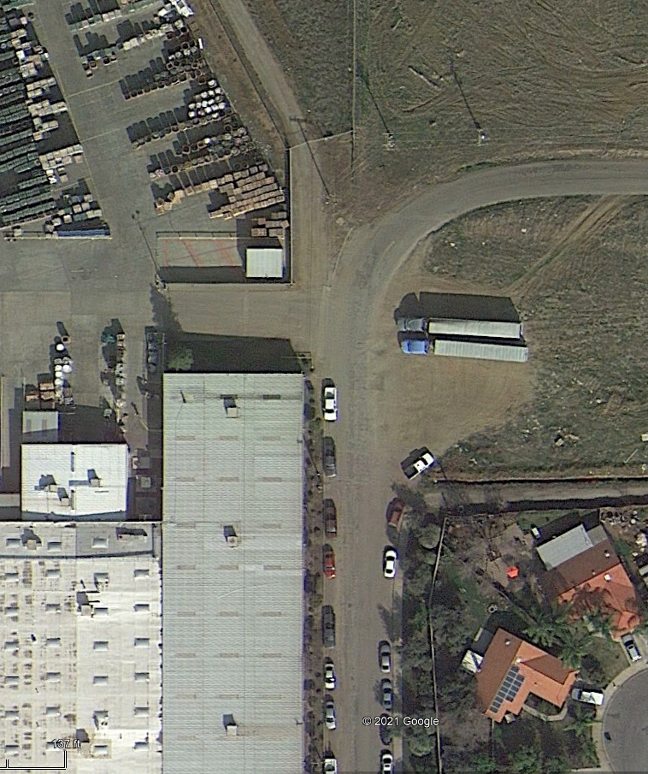
Undeveloped Private Property

Slide 4
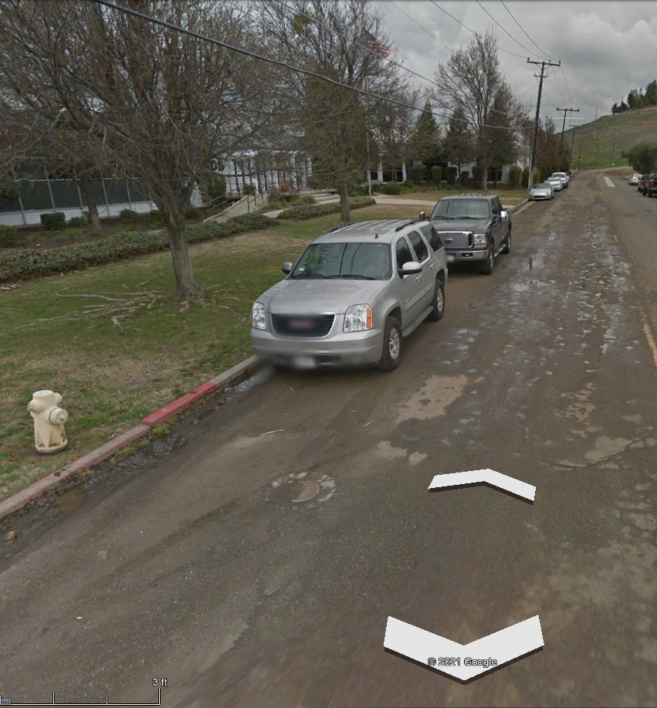
Dirt Built-Up

Slide 5
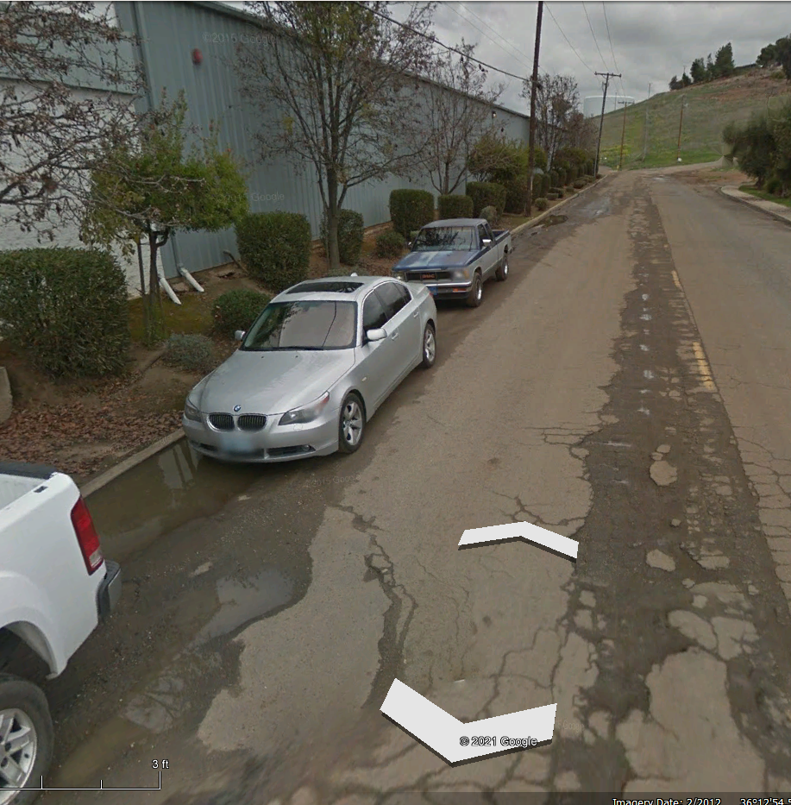
NDS
Building Roof Water
Runoff from HVAC Units

