Slide 1
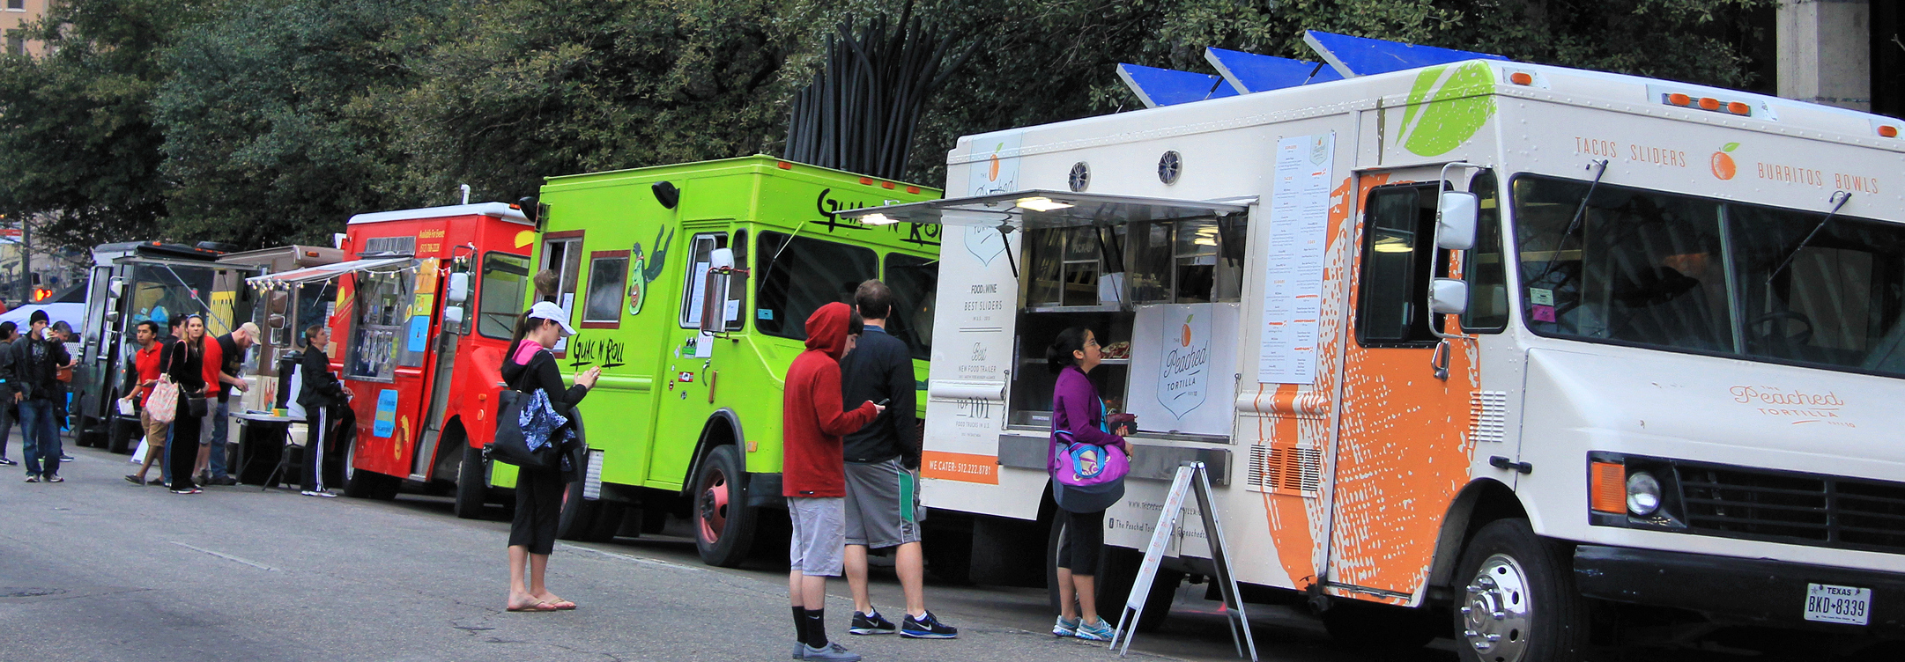
Mobile Vending in Lindsay
Edward Real
Assistant City Planner

Slide 2
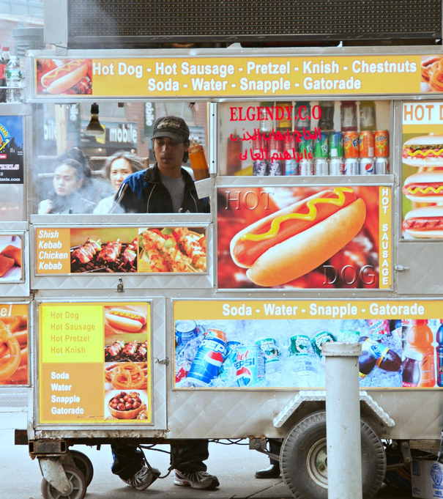
Current Regulations LMC 5.36 Sidewalk Vending regulations
Sidewalk Vending permit required, amount to be established by resolution of the City Council.
Vending only allowed on 8-foot-wide sidewalks and pathways.
Vending prohibited between 10 p.m. and 7 a.m.
Sidewalk vending receptacle may not exceed 4’ L x 4’ W x 4’ tall.
Electrical and animated signs are prohibited.
Portable generators prohibited.

Slide 3
Application Process
Sidewalk Vendor
Mobile Food Truck
State
Tulare County
Lindsay
None
Environmental Health Permit (Food Only)
Sidewalk Vending Permit
Business License
State
Tulare County
Lindsay
HCD Insignia
Environmental Health Permit
Commissary form
Toilet Facility Use Form
Food Managers Certificate
Vehicle inspection
Mobile Vending Permit
Business License
Fire Inspection

Slide 4
Parking Regulations – Carts, Sidewalk vendors
Existing Regulations
Potential Regulations
Minimum sidewalk or pathway width of eight (8) feet.
No vending within 500 feet of:
City Hall, police and fire station
School or day care between 6 am and 6 pm
Place of assembly, 1 hour before and 1 hour after event
No vending within 50 feet of:
Another vendor
Picnic area, playground, community center, or athletic field
No sidewalk vending in the CC district
Limited number or lottery for vending permits around City Parks.
Vendors allowed on private commercial property (parking lots).
No vending during school hours, after school activities ok.

Slide 5
Parking Regulations – Mobile Food Trucks
Potential Regulations
Food trucks must follow all applicable traffic rules
No food trucks allowed in the CC district
Distance from parks and schools, hours
Distance from brick-and-mortar restaurants
Duration restrictions (4 hours in one spot)
Hours of operation
Private property
Tables and chairs allowed
Los Angeles: food trucks and mobile vendors shall not operate in a manner which will interfere with or obstruct the free passage of pedestrians or vehicles along any such street, sidewalk or parkway.

Slide 6
rEFUSE Regulations
Existing
Vendors shall:
Maintain a trash container
Ensure a 10-foot radius is free and clear from trash, litter, and debris.
Potential
A food truck operator, prior to leaving the location, shall pick up, remove and dispose of all trash or refuse within 25-feet of the food truck.
Separate bins for landfill and recycling.

Slide 7
Visalia – Mobile food trucks
Annual permit registration
Overlay District
Sites which have an active business license
Shall only impact 2 parking stalls
Tables and chairs allowed
Developed sites only
Distance
300 feet from restaurant entrance
300 feet from residential zones
1,000 feet from public schools
No minimum distance between vendors on separate properties
Hours
Breakfast: 5:30 am – 9:30 am
Lunch: 10:30 am – 2:00 pm
Dinner: 3:30 pm – 7:00 pm
Downtown: 3:30 pm – 2 am
Amplified music prohibited
Lighting shall not be directed towards public right of way
Cleanup
Trash receptacle required
Site must be free and clear of trash

Slide 8
Hanford – Sidewalk and Mobile Vendors
Sidewalk Vendors
No obstruction shall be placed on the sidewalk or public right-of-way, 48-inch minimum sidewalk width
Roaming vendors allowed in residential zones from 7 am to sunset
Vending carts and stands shall not exceed 8 feet in height, 8 feet in length, and 4 feet in width
Must maintain a clean area within a 25-foot radius
Vending is allowed in parks during normal hours, events excluded
Tables and chairs prohibited
Mobile Vendors
Shall not be located within 250 feet of a restaurant
Shall not vend within one block of a school between 8 am and 5 pm
Shall provide garbage and recycling receptacles
Shall not operate on the same block for longer than 10 minutes

Slide 9
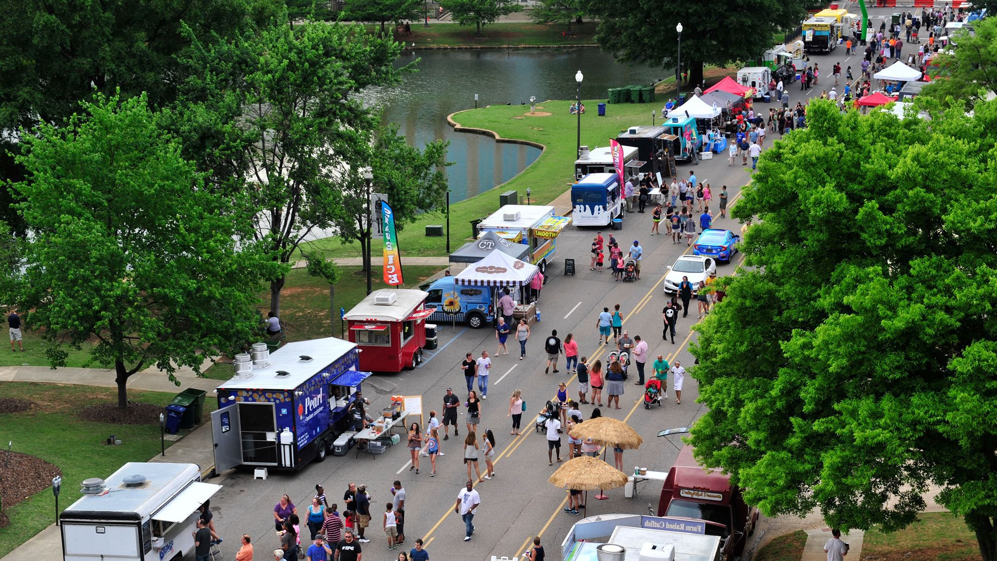
Please provide direction on Sidewalk and Mobile vending regulations.
Thank you

