Slide 1

City of Lindsay
American Rescue Plan Act of 2021
December 14, 2021

Slide 2
American Rescue Plan Overview
City of Lindsay Allocation $3,220,636.00
Payment in two tranches
  First half ($1,610,318.00)
  Second ($1,610,318.00) one year later

Slide 3
Ineligible Uses of Funding
Not free money
Debt service or legal settlements or judgements
Pension fund deposits
Rainy day fund or financial reserve deposits

Slide 4
Community Process
Public Outreach
Presented on 9/28/21
September 28 Council Meeting
Community Survey Online
December 14 Public Hearing
January 11 (Final adoption)
Water & Sewer:
  $1.4M on Water
  $600k on Sewer
Economic Recovery
  $800k
Premium Pay
  TBD
Contingency / Additional Project
  $100k - $400k

Slide 5
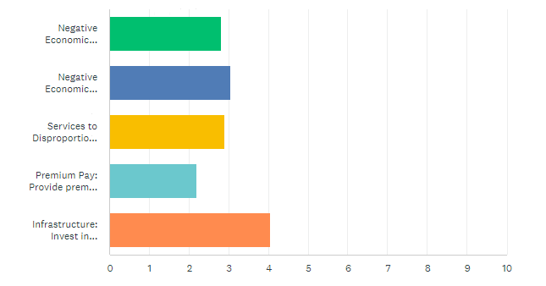
Online Community Survey Results
*as of 1:00 pm on 12/14/21
Overview of Results
Offered in both English and Spanish
Total of 22 responses
Will be live from December 8th to December 14th
All 22 are Lindsay residents;12 work in Lindsay; 15 report being personally impacted by COVID-19
Rankings by category
  Infrastructure
Small business assistance (grants) >
Economic development opportunities >
Parks and recreation improvements >

Slide 6
Staff Recommendations
Address aging infrastructure needs
Create economic development opportunities
Provide Needed Services
Help stabilize the General Fund
Increase Recreation

Slide 7
WHY?
A unique Opportunity to invest
Water / Sewer
GF / Economic Development
Water fund is owed $1.9M from General Fund
Waiting on $250,000 grant reimbursement from the State
Sewer fund is stable
Multiple sources of grant funding available
GF is the most important fund
Long-term revenue
Economic Development is a marathon
Lindsay has a revenue ceiling
Limited growth / City is mostly built out

Slide 8
Eligible Uses of Lindsay’s Funds $3.2M
Water & sewer projects: $1.8M 56%
Address negative economic impacts: $778K 24%
Project Administration $292K 9%
Services to Impacted Communities: $262K 8%
Provide premium pay for essential workers: $98K 3%
                Total: $3.2M

Slide 9
Use: Premium Pay for Essential Workers -- $98,000 (3%)
$2000 for all employees that are employed upon final adoption of Plan.
  $500 for part-time employees
Payable upon final plan approval

Slide 10
Addressing Negative Impacts
Community Grant Writer: $50K
    Focus on Water & Parks grant opportunities
  Economic Development
    Direct assistance for small businesses – $50K
      Program TBD
    Economic Development & Revitalization: $230K
      Item #12.3
    Economic Development Coordinator – $75K (1yr salary & benefits)
      Item #12.2
    Downtown infrastructure Improvements: $173K
      Projects TBD

Slide 11
Water / Sewer Projects
Water System Generators: $140K
Urban Water Management Plan: $75K
Fire Flow Study: $60K
Water Main Line Replacement: $350K
Ave 240 Water Service: $250K
Filter Bank Renovation: $250K
DBP Mitigation Project: $350K
Turbidimeter Replacement: $45K
Water Plant Upgrades: $29K
WWTP Clarifier Gate Valves: $43K
Orange Ave / Harvard Park: $100K
WWTP Clarifier Repairs: $100K
*Based on 2021/2022-2025/2026 CIP Budget

Slide 12
Next Steps…
Final adoption in January
Can start on projects tonight with contract approvals
Start bid process for capital improvements

