Slide 1
10.3 Proposed Improvements to the Mariposa Storm Drain Basin
NEYBA AMEZCUA | city services & PLANNING Director

Slide 2
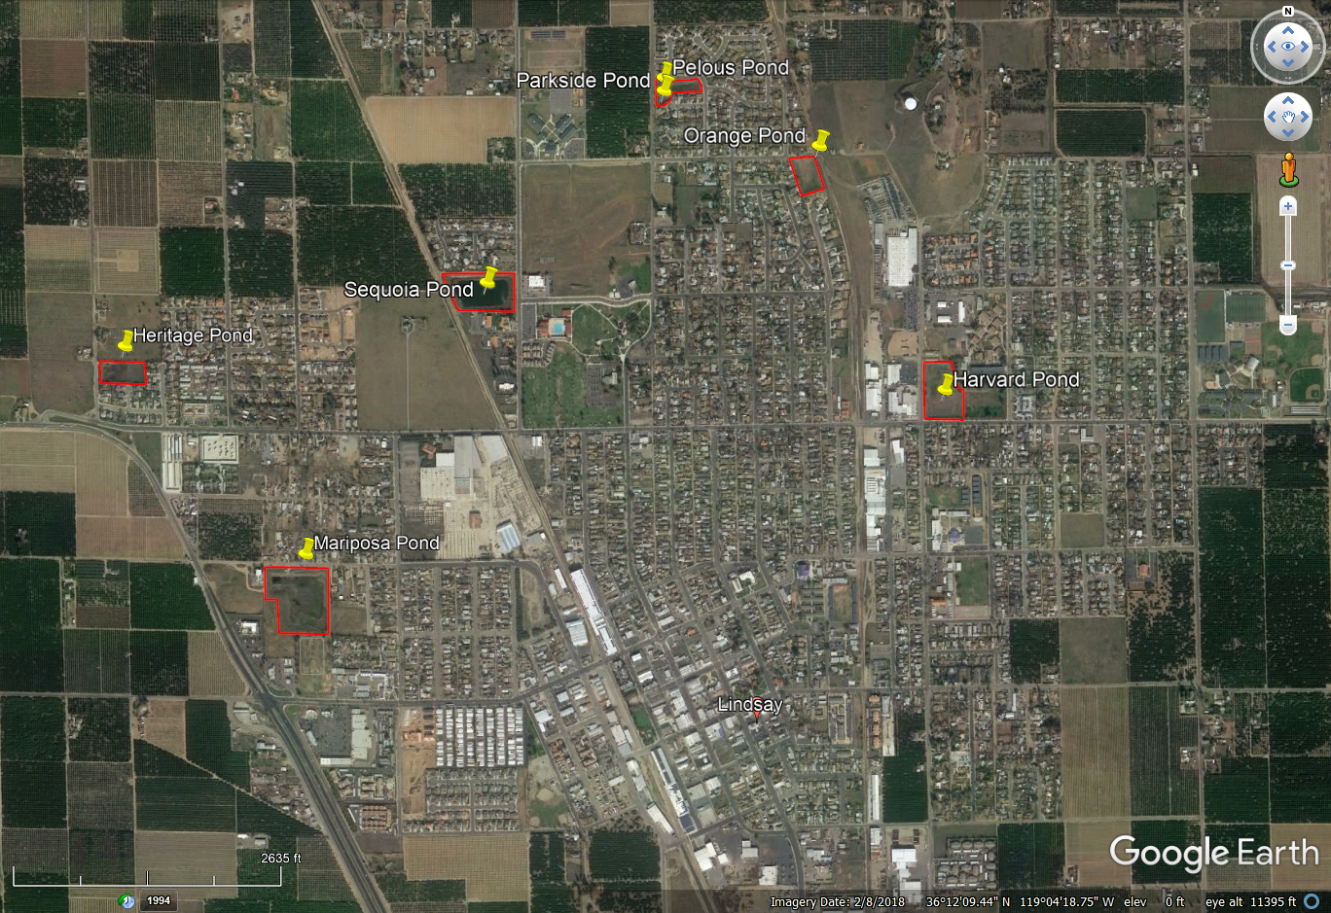
STORM DRAIN BASINS

Slide 3
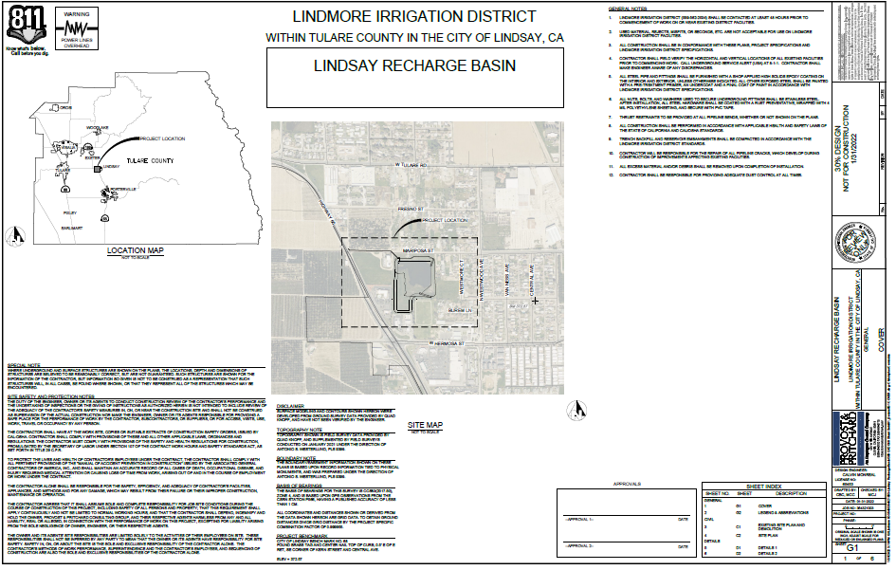
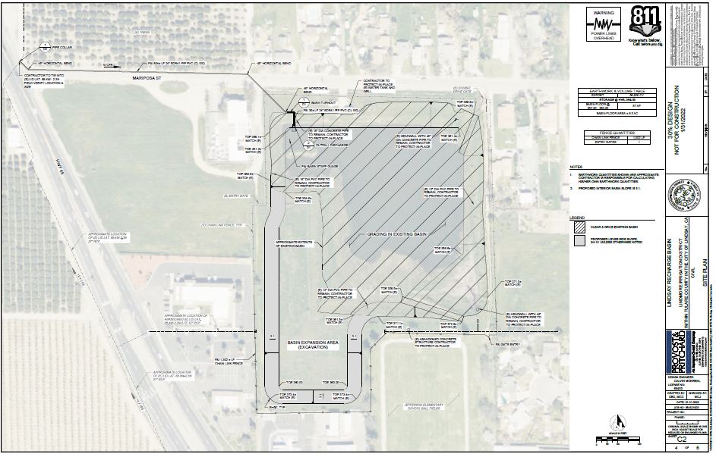
STORM DRAIN UTILITY
MID-KAWEAH GSA
PROP 68 GRANT: $225,000
LID: $175,000
TOTAL: $400,000
11

Slide 4
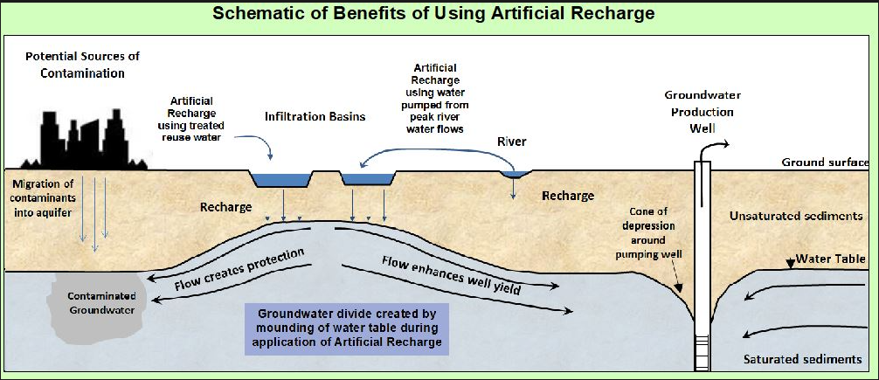
Mariposa Basin
Well 11

Slide 5
Well 11

