Slide 1




STD Education, Prevention, Testing

Slide 2
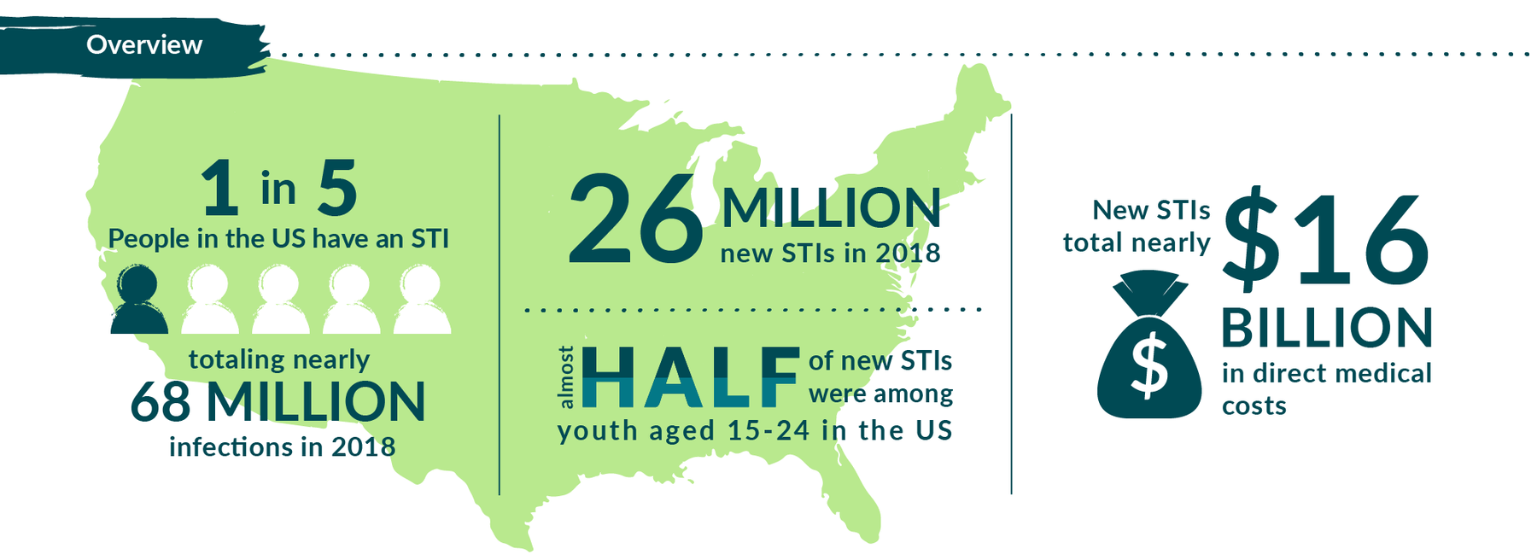
Background: Data
Centers for Disease Control and Prevention (CDC), 2021
https://www.cdc.gov/std/statistics/prevalence-2020-at-a-glance.htm
Notes:
STIs are preventable but pose a significant public health problem
Each year in the US, there are approximately 20 million new STD infections; about half are young individuals between 15-24 (Healthy People, 2020)
Annually, the cost of STDs on U.S. health care amount to $16 billion (Healthy People, 2020)

Slide 3

California
  2019 Snapshot – Reported cases
    Gonorrhea: 80,599 - 236% increase from 10 years ago
    Chlamydia: 237,630 - 61% increase from 10 years ago
    Syphilis (all stages): 28,846 - 349% increase from 10 years ago
      2018–2019:
        14% increase for all stages
        33% increase in females 15–44 years of age
        36% increase for congenital syphilis
https://www.cdph.ca.gov/Programs/CID/DCDC/Pages/STD-Data.aspx
California Department of Public Health, 2022. CD Brief
Notes:
1. STIs continue to rise in the state, with disparities among young adults ages 15-24, African Americans, gay, bisexual men, and MSM
2. Bring up statitics from 2017 in age group

Slide 4
STD/STI Cases in Tulare County
  2020–2021 source: Local Health Jurisdiction STD Data Summaries, California Department of Public Health
  2022 data is preliminary. Source is CalREDIE cumulative report

Slide 5
STD/STI Cases in Tulare County (cont.)
  Sources: 2018-2021Local Health Jurisdiction STD Data Summaries, California Department of Public Health
  2022 data is preliminary. Source is CalREDIE cumulative report
  Notes: Early syphilis includes primary, secondary, and early non-primary non-secondary syphilis; congenital syphilis cases include probable and confirmed only.
Notes:
Note: CDPH provided some new data for early syphilis cases between 2020 - 2021, Q1 - Q3
-2020 Q1-Q3: 24 cases
-2021 Q1-Q3: 61 cases
-154% change

Slide 6
2021 STD/STI Rates per 100,000 Population
Tulare County’s primary and secondary syphilis rate increased 77% from 2020 to 2021
2021 is the first year that the Tulare County rate for primary and secondary syphilis exceeds the state rate
Tulare County’s congenital syphilis rate went from below the California rate in 2020 to above the California rate in 2021 & 2022
Disease | Tulare County | California
Chlamydia | 617.1 | 488.2
Gonorrhea | 171.2 | 233.1
Primary & Secondary Syphilis | 28.4 | 22.4
Congenital Syphilis | 113.4 | 112.4
Source: https://www.cdc.gov/std/statistics/2021/tables.htm

Slide 7

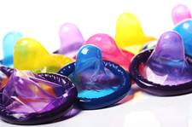

Prevention
ABSTINENCE
LATEX CONDOMS
FREQUENT SCREENING
LIMIT SEX PARTNERS
Most reliable protection is choosing not to have sex.
Water-based or silicone-based ONLY!
Get screened every 6–12 months or more often if you have a new sexual partner.
Choosing to have sex with only one uninfected partner will also lower your risk.
100% effective
Use lubricant with condoms.
Screening all partners before having any type of sex is highly recommended.
Have open communication with your partner.
Notes:
Campaign Materials - #GYT (cdc.gov)

Slide 8
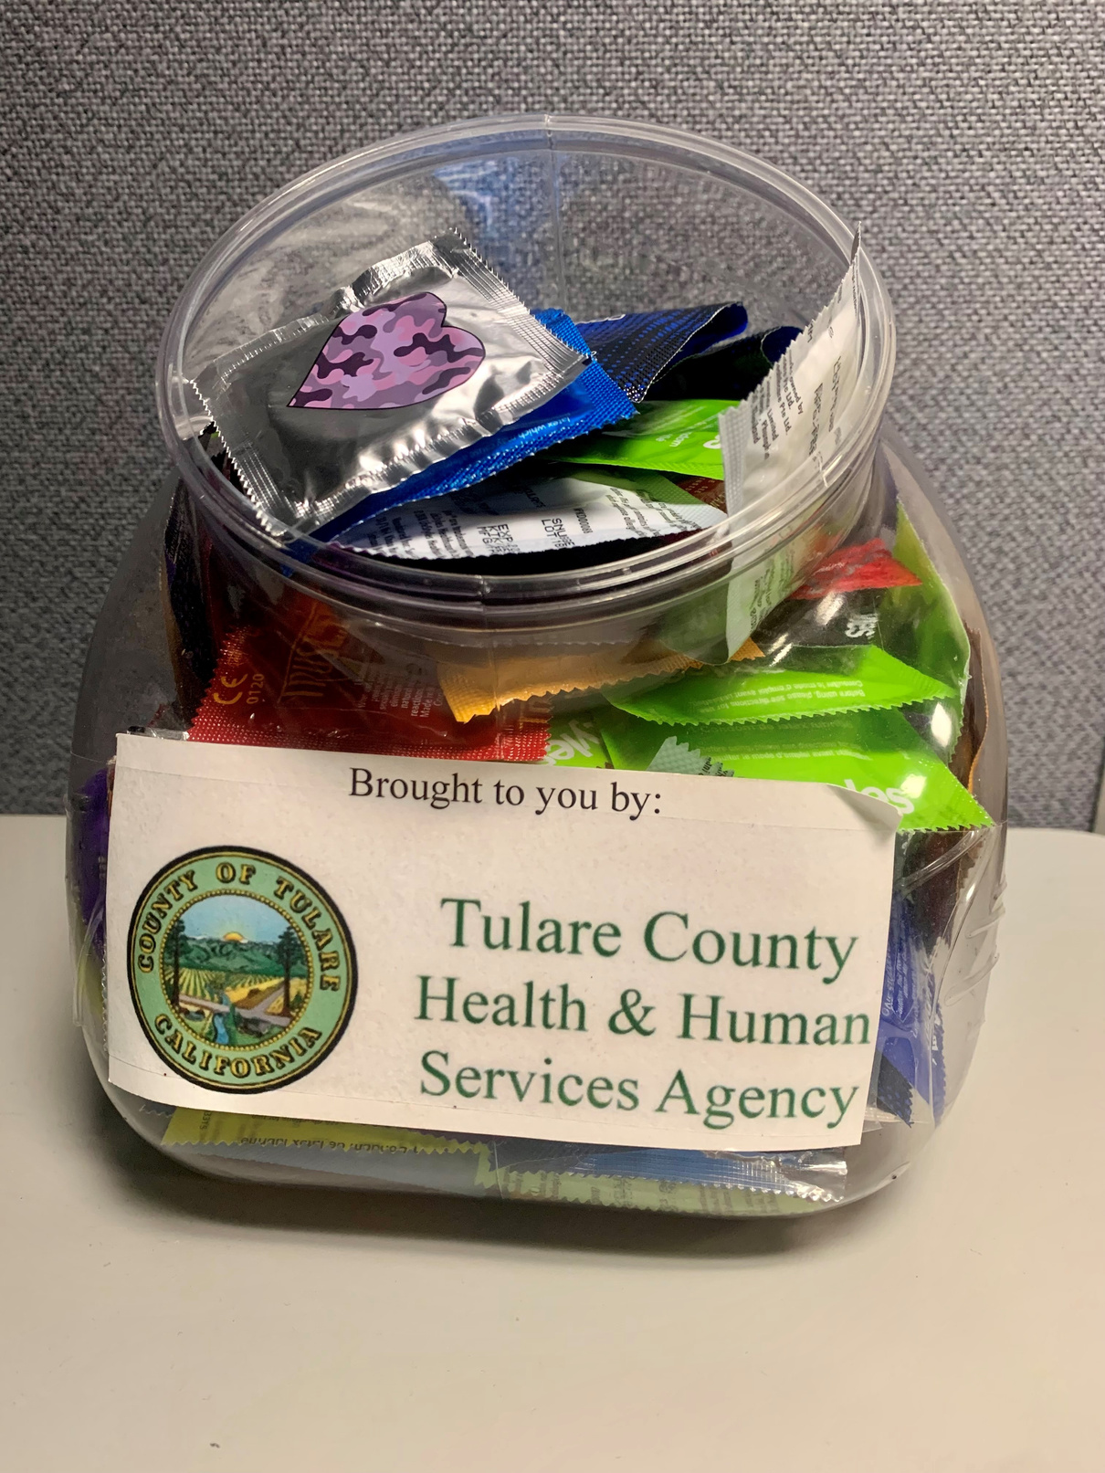
Condom Access Project (CAP)
The Condom Access Project aims to increase access to condoms to help prevent the spread of STDs in Tulare County. We would provide you with condoms and condom bowls to display at your location in an easily accessible area of your choice. We will restock on a monthly basis.
We currently have condom bowls at 31 locations throughout Tulare County. If you are interested, contact the Communicable Disease Team at cdreporting@tularecounty.ca.gov

Slide 9

We thank you for your continued support in our efforts to reduce STIs in Tulare County.

